Slide 1

Asia Pacific College
Cruz-Rabe Pharmacy System
Bueno | Rosales

Slide 2



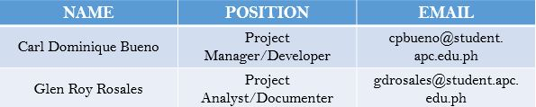
Project Authors

Slide 3

Client Information
Health Facility Detailed Information
ACCREDITATION NO: H92007290 PMCC NO: 313634 INSTITUTION NAME: Cruz-Rabe Maternity and General Hospital ROAD NAME: 37 Gen. Luna Street BARANGAY: Tuktukan MUNICIPALITY: Taguig City PROVINCE: Metro Manila (SOUTH) REGION: NCR (SOUTH) CATEGORY: Level 2 CLASSIFICATION: Private

Slide 4
Introduction
In order to ensure patient's safety, cost effective processes and well managed admission on managing medical services, through preventing clinical errors and the use of resources efficiently. Therefore, business process should have a sufficient tool which is an automation of “Pharmacy System.” Transactions that are processed in different factors including; IN and OUT patient order entry, dispensing orders, stocks inventory and purchasing management will stand-alone by providing innovative way of service. The client Cruz-Rabe Maternity General Hospital will apply the latest technology enabling complete control to improve medical management and to bring satisfaction to their clients in terms of professional service.

Slide 5
Project Description
The project is described as with a scope of a “Pharmacy within a hospital case, wherein there will only be IN and OUT patients for pharmacy request entry and a cashier for validation of release of purchased items.”

Slide 6
Business Opportunity
Based on the client’s needs, a Pharmacy System will make a huge difference in its line of work. There is sufficient amount of tools to help them do business processes but they are not enough to make it efficient. All transactions being done are in manual type of processing. Because of this, the developers decided to pick an area to develop wherein that factor does a critical role; the pharmacy. The pharmacy of Cruz-Rabe hospital has only two pharmacists, including the developers’ contact, Mrs. Carmelita Buenaflor. Mainly, her concern is the manual way of processing the prescription orders of the patients. Since most likely, a pharmacy request slip needs to be transacted before allowing the patients to leave thus, having another aspect of system because most of the time, the order has already medicines required to be bought before the release. This is where the inventory side comes in. The Pharmacy Request System that will be made can cover all these factors in one place, a big business opportunity which must be done to ensure the efficiency of work especially with limited number of employees.

Slide 7
Business Objectives
* To eliminate undue resources by implementing Paperless Transactions System (PTS) through the use of the system.
* Provides an electronic system that interacts with the patient and the pharmacy.
* Offers convenient way of discharging patients by accumulating valuable records.

Slide 8
We can assume that the system will be feasible if we meet the following requirements:
If the system seems to be helpful when hospital transactions (pharmacy requests) are now processed in just a few moments.
If the results produced are accurate and reliable for the patients.
If the pharmacy records can be tracked down easily from its database.
If less resources are utilized but service would improve.

Slide 9
We can assume that the system will be successful for a long term if we meet the following requirements:
If the system is useful to patients and hospital staffs in terms of service, performance and satisfaction.
If it will generate enough revenue to support the maintenance of the system.

Slide 10
Client needs
Our client’s previous business processes particularly in pharmacy transaction uses manual way of requesting and dispensing orders to the patient. However, discharging also took time and resources before the releasing. Therefore, our project team proposed a system that targets anyone who needs prescription medication or other health-related products and identifying the different types of patients who make purchases at the pharmacy. Defining the pharmacy’s target on satisfaction of service and lessen the time of processes, the system will be able to streamline the business transactions by ordering the right products and payments in a more efficient manner.

Slide 11
Business Risk
In operation of the system, it might take in critics since the pharmacy department will be adapting changes towards its business transactions. Therefore, it will require equipment and additional services in order to produce the system. This means, the organization need to invest in this project as there is a possibility to make changes in certain aspects such as its maintenance and security.

Slide 12
Vision of the Solution
Our vision is for pharmacy processes to play its part in improving quality in pharmacy performance and services. Patients may assume the automation of processing the prescription and demand on discharging patients.

Slide 13
Vision Statement
A Web-based system for processing pharmacy request within a system, dedicated to ease the way of accepting requests by pharmacists to process the automated prescription orders and dispense orders in a better way. It will not only verify the information received, but also keep the records in a secured database which can be accessed for future preferences. Unlike the old-way of manual processes, Cruz-Rabe Pharmacy Request System intends to improve the quality of work in the medical field by providing the essential steps of transactions in fast-pace. The vision of this system is determined to meet patient’s satisfaction in terms of service.

Slide 14
Assumption & Dependencies
AS-1: Additional equipment, services, and maintenance will be improvised for the authorized personnel to do the business processes.
AS-2: The hospital will be developed to ensure the system was implemented well-lesser hardcopies, more softcopies for the records.
DE-1: If the pharmacy records will be accessible with the other departments to support the system for consistency of the data.

Slide 15
Scope and Limitation
Pharmacy Request System is intended for pharmacists to use in their service that assists patients’ drug requests that is prescribed by a doctor. The patients will present their prescription given by the doctor into the nurse that will be processed by the pharmacist. The pharmacist will do request of orders that will be paid upon the cashier and billing section. Once the orders are paid, the orders will be ready to dispense to the patient. Alternatively, the Pharmacy Requests will be automated and the data will be on a database for data warehouse. On discharging In-Patients will be provided with their records as fast as possible. The stocks they took will be listed down on their records in real time. Therefore, in paying their bills, the process will take lesser time. This scheme will ease the work of the auditing staff and improve the discharging process of patients.

Slide 16
Vision Statement
A Web-based system for processing pharmacy request within a system, dedicated to ease the way of accepting requests by pharmacists to process the automated prescription orders and dispense orders in a better way. It will not only verify the information received, but also keep the records in a secured database which can be accessed for future preferences. Unlike the old-way of manual processes, Cruz-Rabe Pharmacy Request System intends to improve the quality of work in the medical field by providing the essential steps of transactions in fast-pace. The vision of this system is determined to meet patient’s satisfaction in terms of service.

Slide 17
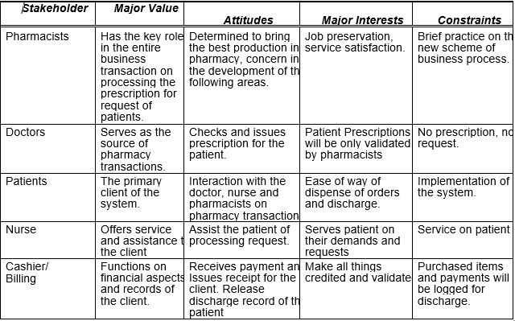
Stakeholders

Slide 18
Vision Statement
A Web-based system for processing pharmacy request within a system, dedicated to ease the way of accepting requests by pharmacists to process the automated prescription orders and dispense orders in a better way. It will not only verify the information received, but also keep the records in a secured database which can be accessed for future preferences. Unlike the old-way of manual processes, Cruz-Rabe Pharmacy Request System intends to improve the quality of work in the medical field by providing the essential steps of transactions in fast-pace. The vision of this system is determined to meet patient’s satisfaction in terms of service.

Slide 19
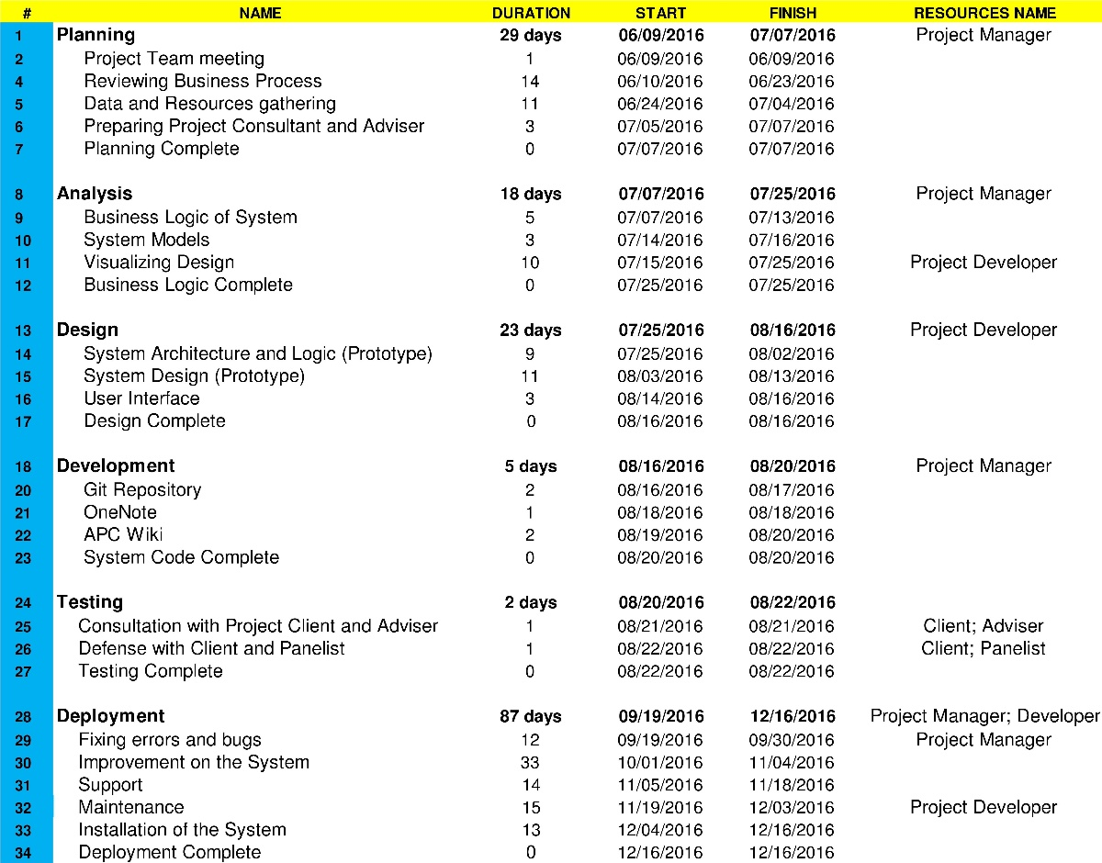
Gantt Chart

Slide 20
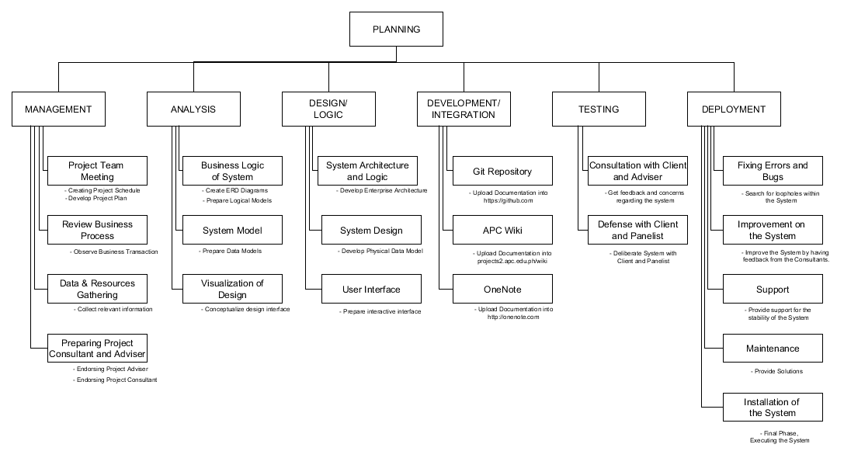
Work-Breakdown Structure

Slide 21
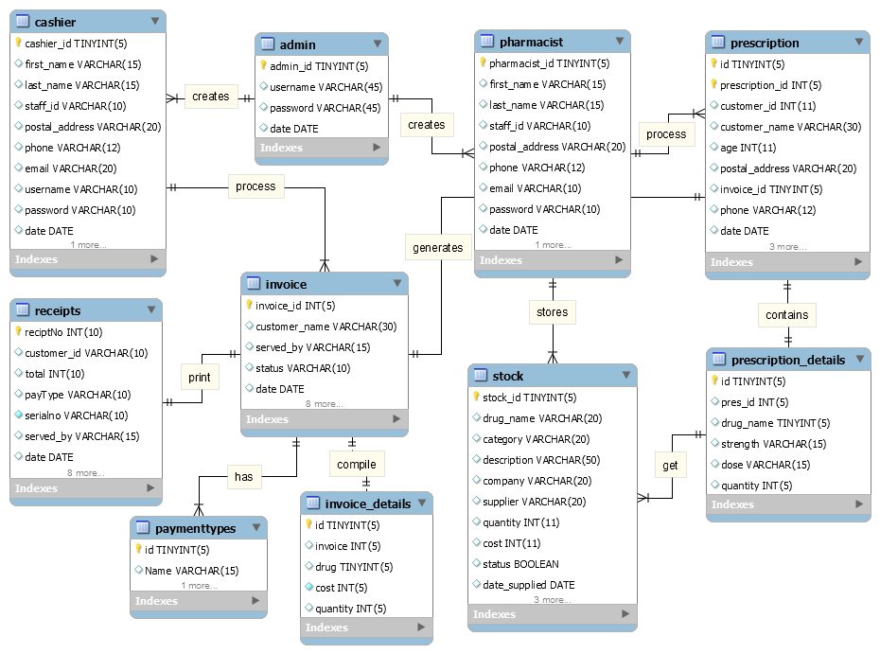
Entity-Relationship Diagram

Slide 22
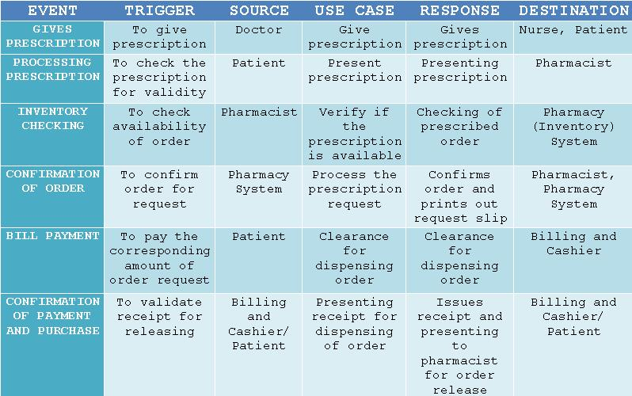
Event Table

Slide 23
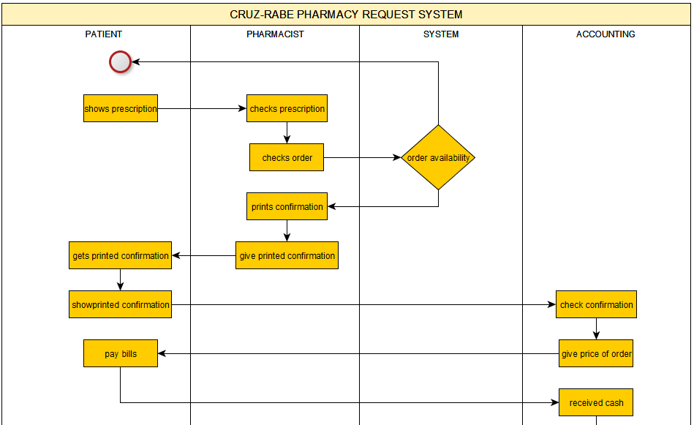
Activity Diagram

Slide 24
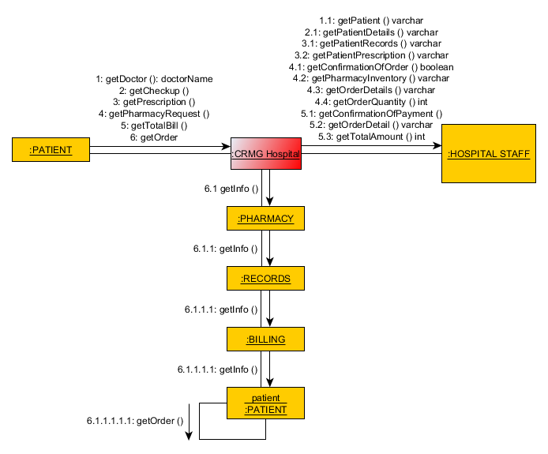
CommunicationDiagram

Slide 25
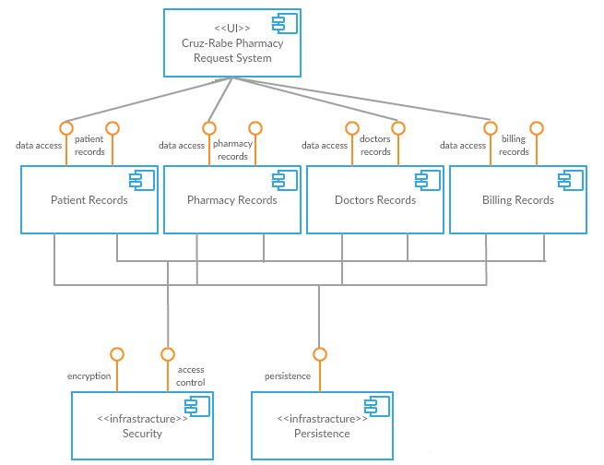
ComponentDiagram

Slide 26
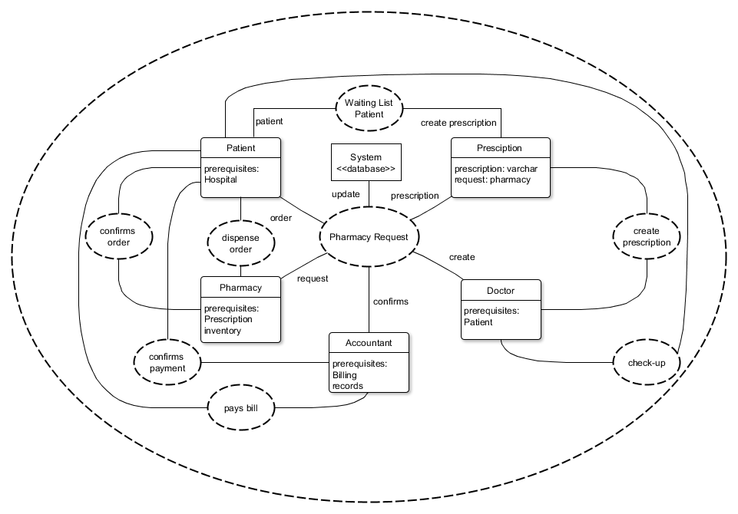
Composite Diagram

Slide 27
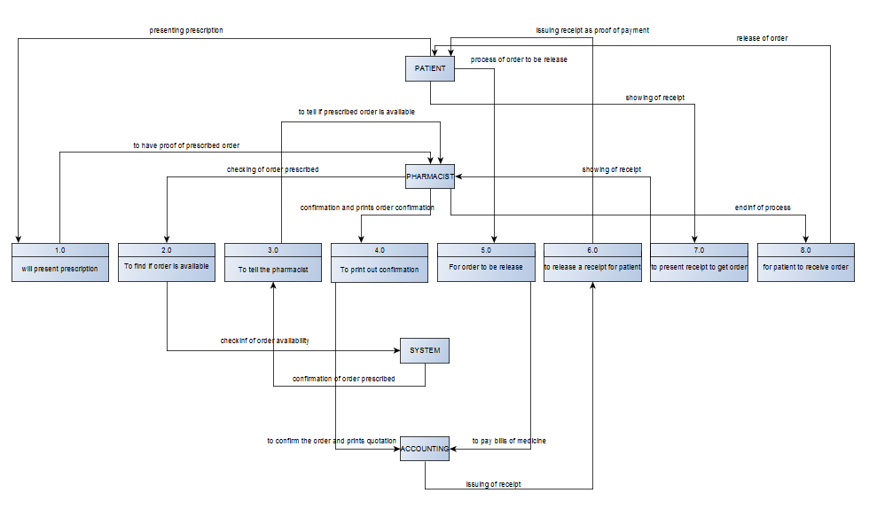
Data Flow Diagram

Slide 28
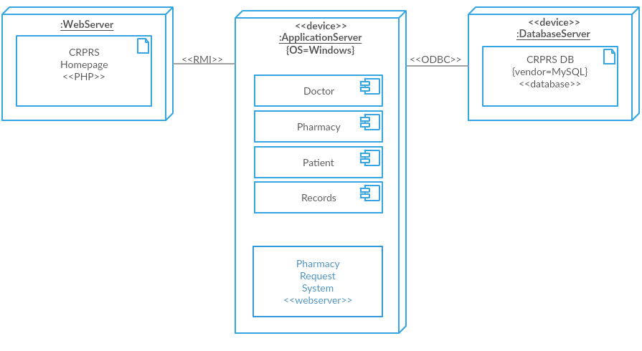
Deployment Diagram

Slide 29
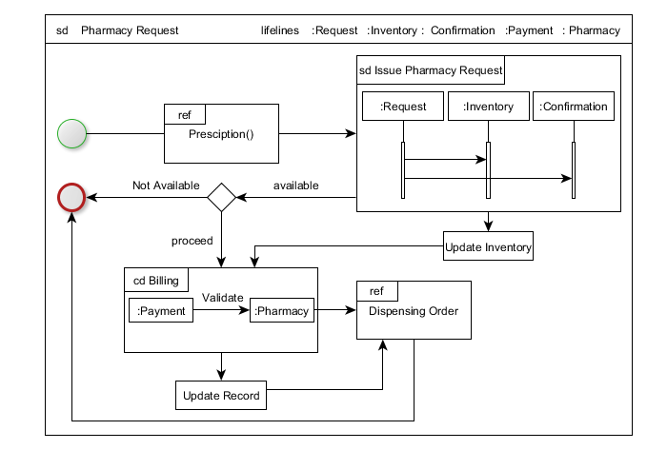
Interaction Overview Diagram

Slide 30
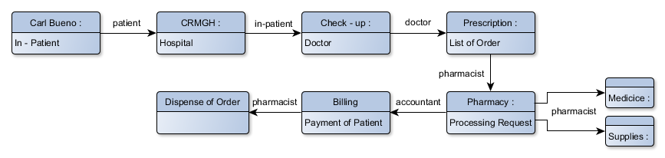
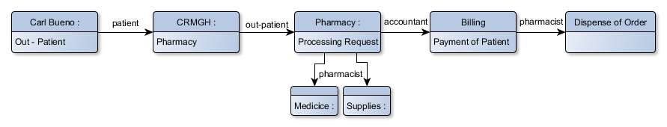
Object Diagram

Slide 31
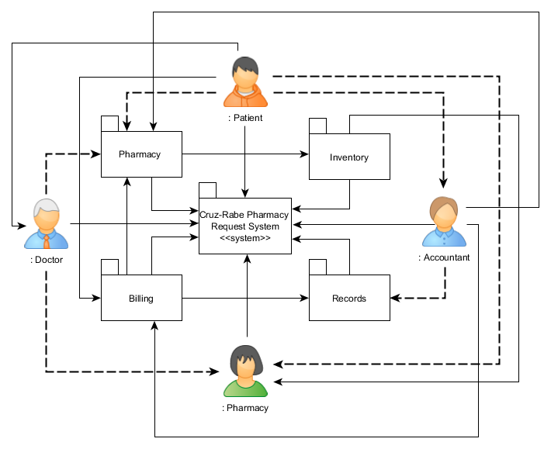
Package Diagram

Slide 32
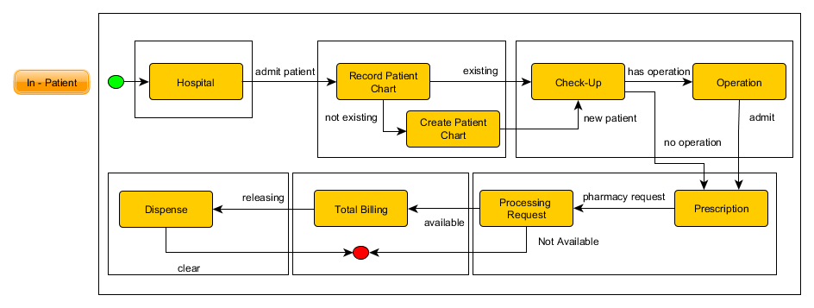
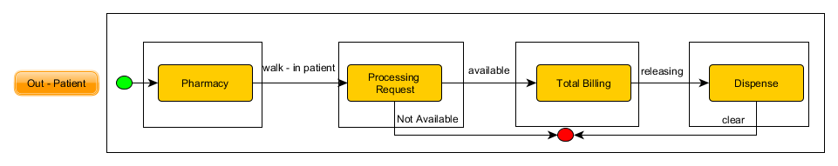
State Machine Diagram

Slide 33
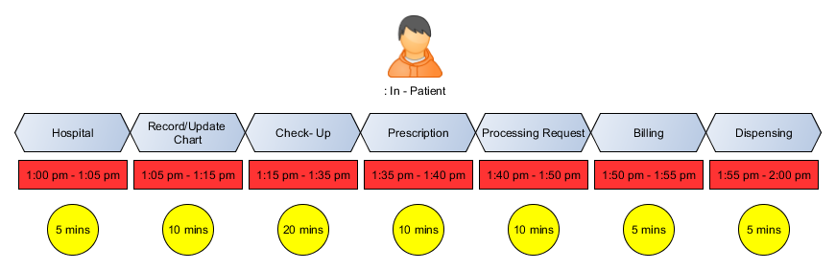
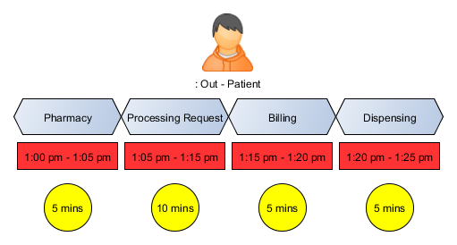
Timing Diagram

Slide 34
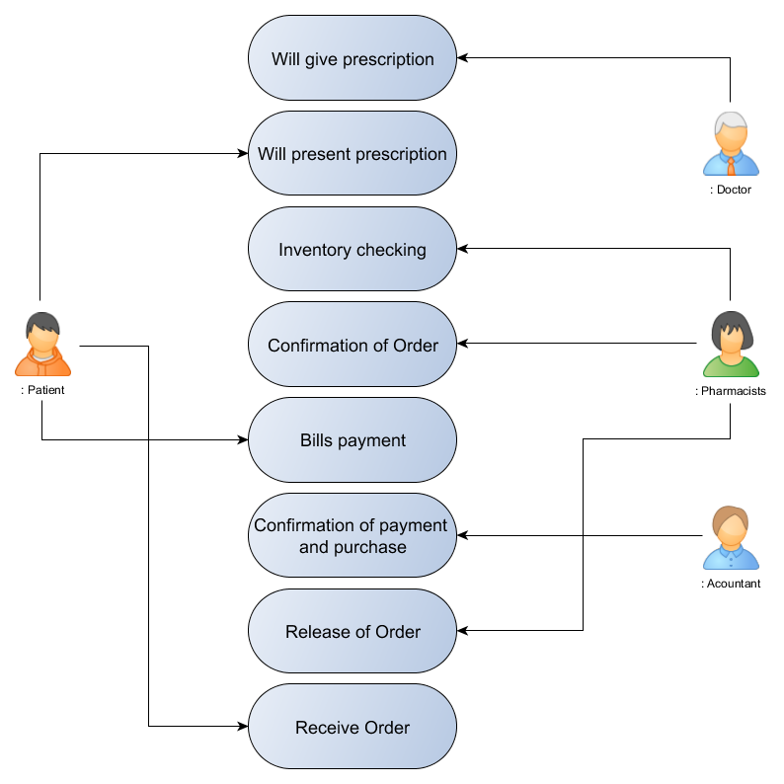
Use Case Diagram

